Slide 1
Data Analytics Journal Club
15NOV18
LCDR Thota
Notes:
Ok everyone, this is going to be my topic for this month’s journal club.

Slide 2
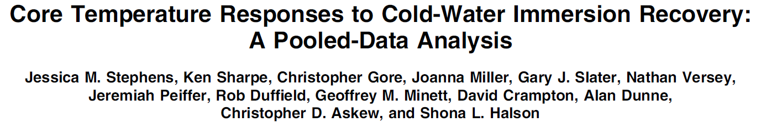
Article to Discuss
Notes:
This is the article that we are going to be revieweing. Core Temperature Response to Cold-Water Immersion Recovery: A Pooled-Data Analysis

Slide 3
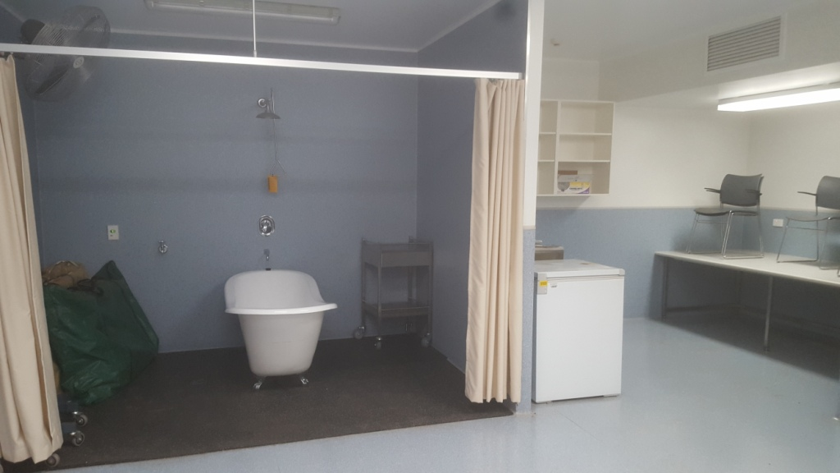
Why are we even talking about this?
Notes:
One because it’s a well designed study, but 2 because it may have some actual practical application to the trauma tent. This is what our STP heat deck looked like in Australia. Can this study change management of heat casualties?

Slide 4
Overview
Background
Methods
Results
Discussion
PICO
Questions
Notes:
Here’s an overview of what we are going to cover for the talk

Slide 5
Background
CWI (cold water immersion) is used to reduce fatigue in endurance sports
Theory - Cold induced vasoconstriction decreases inflammation and pain
Theory - Cooling faster speeds recovery
Plus and minus results for this theory
Notes:
Cold water immersion has been used to decrease the amount of fatigue, speed-up recovery and return to play in athletes. There has been conflicting evidence both for and against this assertion. Endurdance sports include running, cycling, and triathlons.

Slide 6
Historical Evidence
For
Against
Cycling time trial performance increased 40 minutes to 3 days after CWI (Veil 2008)
No benefit to CWI (Stephens 2017)
Notes:
Vaile J, Halson S, Gill N, Dawson B. Effect of cold water immersion
on repeat cycling performance and thermoregulation in the heat. J
Sports Sci. 2008;26(5):431–440.
Stephens JM, Halson S, Miller J, Slater GJ, Askew CD. Cold-water
immersion for athletic recovery: one size does not fit all. Int J Sports
Physiol Perform. 2017;12(1):2–9.

Slide 7
Cooling Prototocols
How cold?
How long?
How deep?
How much (intermittent vs continuous)?
Notes:
All these studies in question looked at various parameters in their cooling protocols. All tried to determine the optimal time, length, location of the body part cooled, and whether continuous or intermittent cooling was better. There was a lot of variability in results in all previous studies looking at the optized cooling temperature and duration of cooling.

Slide 8
Purpose of this study
Pooled analysis to look at core temp data from various CWI protocols
Look at core temp trends while immersed and post immersion
Notes:
What they did was conduct a pooled analysis where they looked at a bunch of data from previous articles to find differences and trends and variabililty in cold water protocols. It’s a little different than a systematic review or a meta-analysis in that its not as statistically rigorous.

Slide 9
Methods
Retrospective, pooled cross-over controlled study
13 CWI studies
157 male subjects
Time component 1 - measures change in core temp from end of exercise to end of CWI
Time component 2 - time from end of CWI to 13 different times points up to 3 hours
Notes:
Retrospective means that the investigators were looking back at previous studies, pooled means that they were combing data points from different studies, and cross-over controlled means that the same person was used for the control and test group.

Slide 10
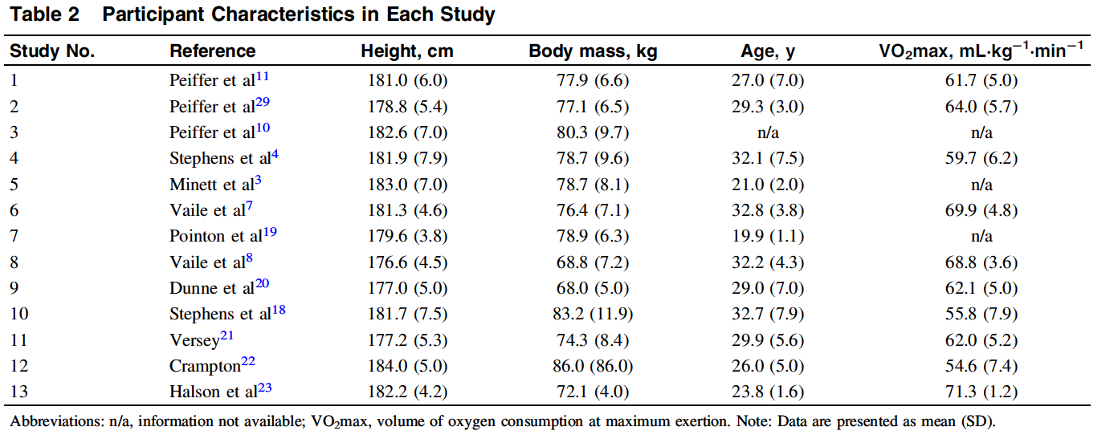
Notes:
This is showing that the study population was between 19- 32 years of age, similar to our active duty population

Slide 11
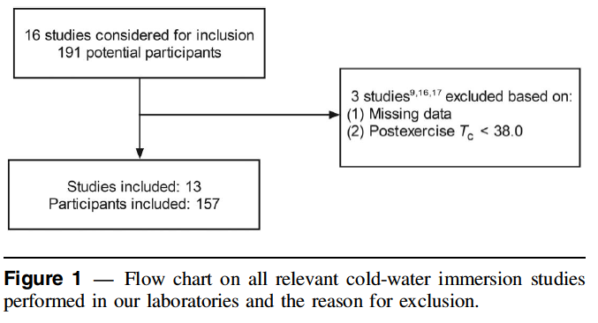
Inclusion Criteria
Notes:
This is their inclusion criteria for the number of patients they kept in the analysis

Slide 12
Study Design
Cross over- controlled design
“Seated passive” core temp as control variable
CWI post exercise
Core temp measured by rectal thermistor or telemetry pill
Exercise must have resulted in temp >38⁰
Exercise was cycling (11) or sprinting (2)
Notes:
All previous 10 of the 13 studies have been published, and 3 are pending publications

Slide 13
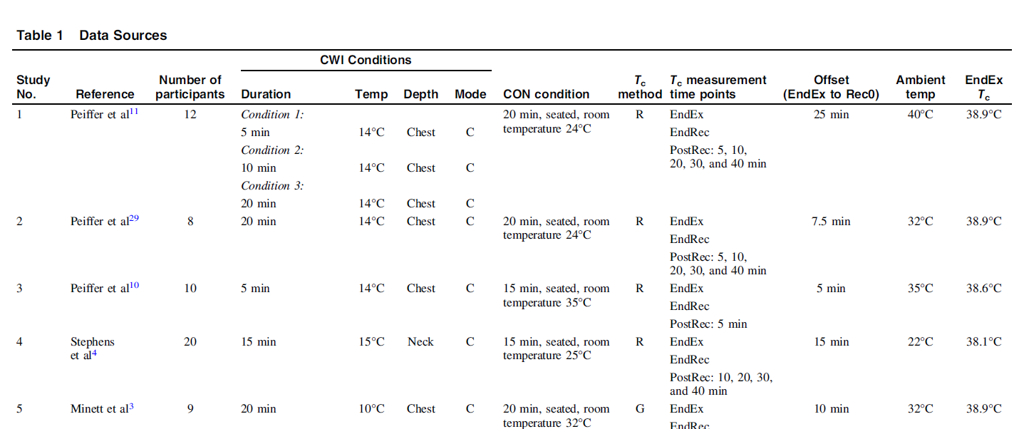
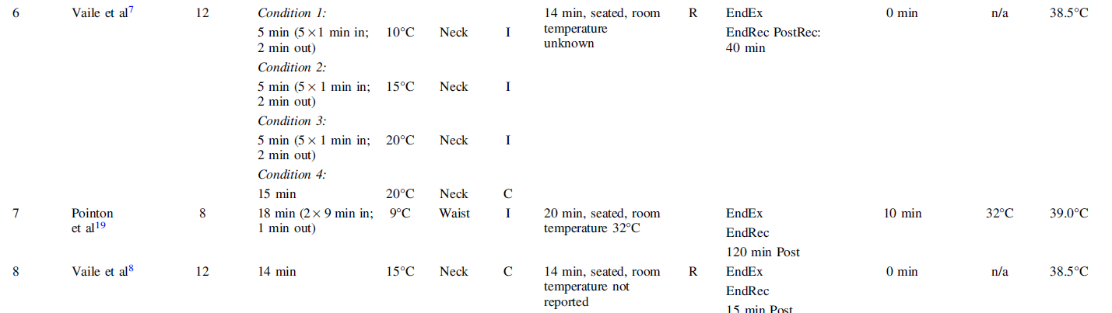
Notes:
Here are the specific protocols used as an example. The temperature of the water, depth of immersion, continuous vs. intermittent dunking were looking at. Here are the control condition for passive siting.

Slide 14
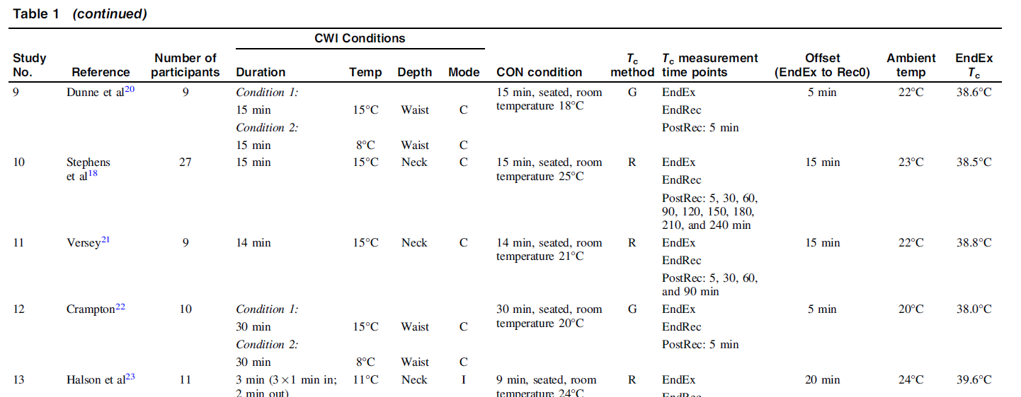
Notes:
This is the rest of the data

Slide 15
Variability in studies
7 different temperatures
8 different durations
3 different depths
2 modes of immersion
336 CWI possibilities
16 CWI protocols used in the 13 studies
Notes:
The point of this slide is just to show that there was a lot of variability between each of the studies
The range of temperatures was 8 to 20.
The duration was 5 to 20 minutes, the mode being 15
Neck chest and waist were the depths
Continous vs intermittent were the modes of immersion
There were 336 total combinations and permutations total but only 16 types of protocols used in the 13 studies

Slide 16
In order to address this
In order to use the pooled data, the greatest variability was seen in the depth of immersion and the time between exercise and immersion (offset time)
Immersion Depth was converted to predefined body to water surface area ratios
7 different offset times seen in 13 studies (not addressed)
Notes:
There was a ton of variability in the study, the two biggest being offset time and depth of immersion. They did some fancy math by using the average body surface area to water surface area ratio to attempt to normalize the data discrepncies between studies. They didn’t really address offset time in any of the studyies
Offest time is the amoutn of time it took from finsihing exercise to starting the cooling

Slide 17
Core temp measurement
Measured at the end of exercise
Measured 13 times after cooling
5, 10, 15, 20, 30, 40, 60, 90, 120, 150, 180,210, and 240
Delta-delta gap: Difference in core temp post exercise and cooling - control
T test- found no difference in control and immersion for each participant
Notes:
Ok, I know that this looks confusing. What they did was have a person run or bike. Then measure their core temp. Then they would dunk them in the water for a set amount of time and then measure the core temp again. That difference they would compare to a control where a person was sitting down in a chair.
They basically measured at 5 minute intervals then 10 then 30 minutes up to 4 hours post cooling
The T test is part of inferential statistics and looks at differences between 2 populations. Since the control and intervention group is for the same person, there’s literally no diffence.
Temperatures ranged from 11 to 15 degrees which is 50 to 60 degrees Farenheit

Slide 18
Statistical Analysis
Delta-Delta T- the change in CWI vs Control
Mixed linear regression using R
SD are reported using P < 0.05
Notes:
Standard linear regression was used with standard P values

Slide 19
Results for Immersion
Average post exercise temperature was 38.56 degrees
Average post cooling temperature was 37.72 degrees
Intermittent cooling was 0.25 degree more effective than continuous cooling
Each degree cooler water lower temp by 0.03 degrees
Every minute of immersion decrease temp by 0.02 degrees
Depth and offset time didn’t effect results

Slide 20
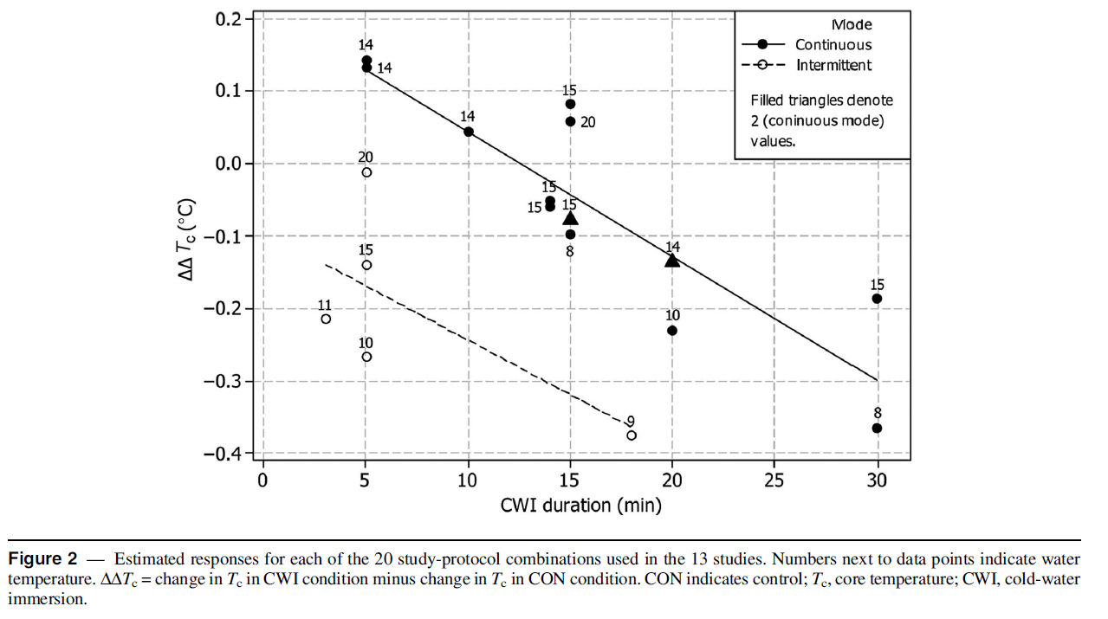
Notes:
Here we see that the difference between continous and intermittent is about a qaurter of a degree. As you cool someone longer they get colder. Temperature decreases by 0.2 degrees per minute which is the slope of the line and the linear regression.
Pfiffer uses 14 twice and Stephens uses 15 twice as the two triangles.

Slide 21
Results for post cooling
60 minutes was peak difference in CWI vs. control
Cubic regression spline

Slide 22
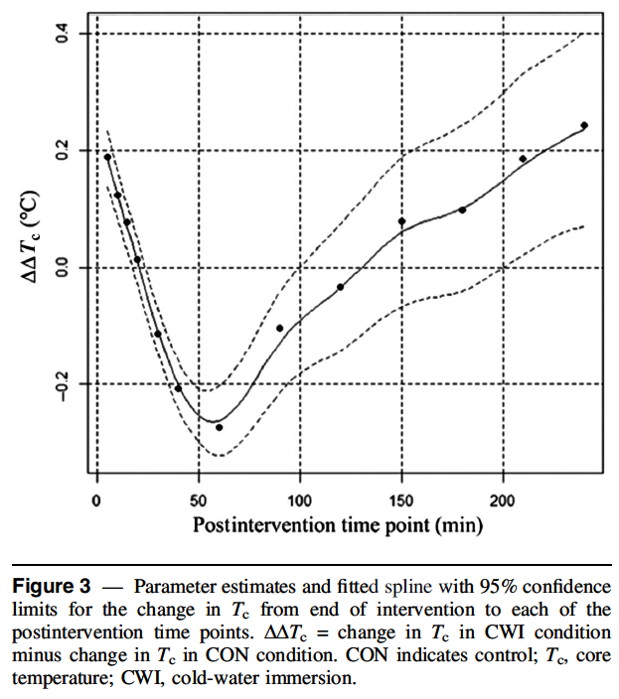
Notes:
So this is the cubic regression spline. Basically they are saying that you see the biggest difference in core temp occurs at an hour

Slide 23
Discussion
Intermittent cooling lowers temp faster than continuous
Colder water and longer immersion lower temp faster
The longer you wait to cool, the less the impact
60 minutes is the peak post intervention difference
Notes:
Putting everything together, they found that intermittent cooling was better than continuous cooling which was surprising to me. The authorities think that the temperature gradient is always changing and this shift between vasocontriction in the water and vasodialation out of the water might be responsible for cooling faster.
Cooling someone longer and with colder water makes them cold faster which inutitively makes sense. The longer you wait to cool someone, the less the impact
The time peak at an hour was important because they recommend to their athleses not to take a shower until an hour after cooling because that could theortheticall negate the cooling beneftis

Slide 24
Assumptions
Lower temp = better performance
Ingested thermistor is as accurate as core temp
Notes:
They make these assumptions moving forward which aren’t really addressed. In the beginning they mention that there’s conflicting data whether CWI even works at all

Slide 25
Limitations
Mixed results regarding cooling efficacy
Lots of variability - How cold, how long? How deep? What body part?
Different protocols are used; can you reliably compare?
Variability of lag-time for when timing of cooling was started
Homogenous cohort- generalizability?
Notes:
Tremendous amount of intra-study variation in protocols
Tremendous variability in protocol design between studies

Slide 26
PICO
Population - males 19 to 32
Intervention - Cold Water Immersion cooling
Control - no cooling
Outcomes - change in temp, duration of temp

Slide 27
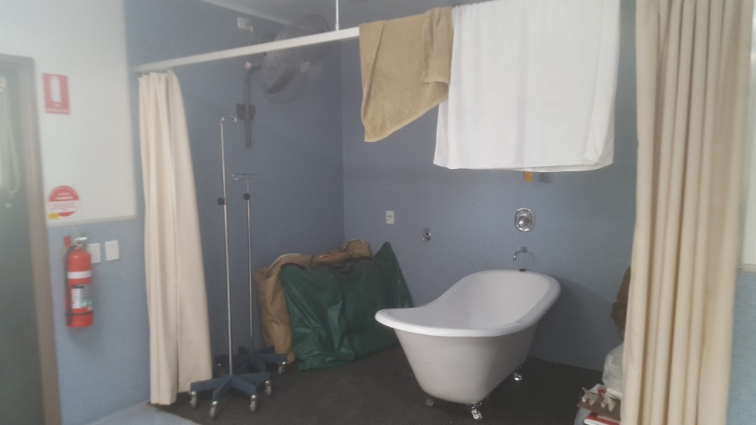
Military applications
Notes:
So Here’s our heat deck again. We normally use a fan for convective cooling which is the best, but here we only had a tub. If you’re treating heat stroke, you could intermittently dunk someone in the tub vs. a continuous infusion. However, usually people have altered sensorium (often delirium) w/ heat stroke, which might make this more challenging.

Slide 28
Questions

